Slide 1

Where Is My Delivery?

Slide 2
Agenda
Team
Introduction
Details of proposed idea
Benefits
Demo
Conclusion

Slide 3


1. Team
- WEB BOX -
Park Ji Hwan
Pages for Store Owner
Hwang Joon hae
Pages for Orderer
Jung Hae Kyung
Pages for deliverer
Sign up & Sign in

Slide 4
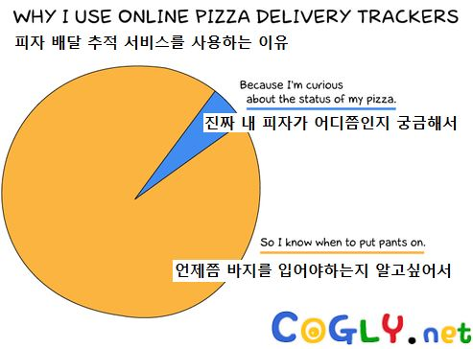
2. Introduction
Motivation
http://www.ohfun.net/?ac=article_view&entry_id=11923
Notes:
After we order food, we have to wait until the doorbell sounds. If you wait and hear the doorbell, we have to wear pants to get food. To eliminate this inconvenience, we developed real-time delivery location service.

Slide 5
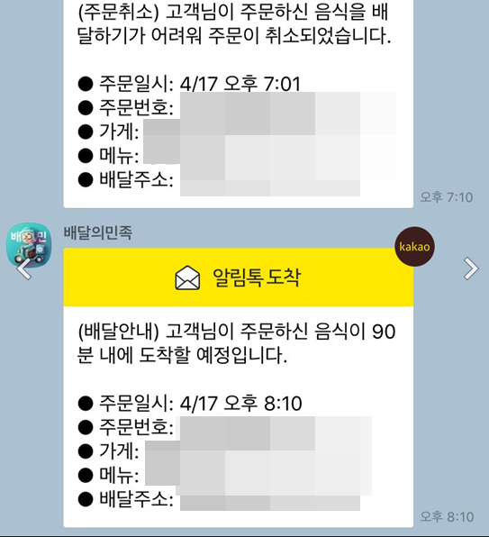
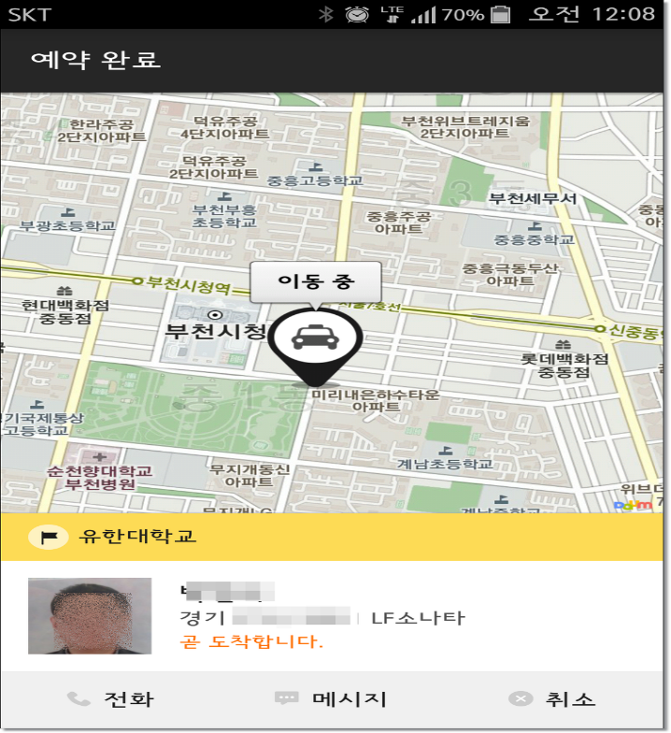
2. Introduction
Objectives
Describe the objectives of your project
Why your idea is creative?
Apply

Slide 6






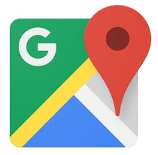


3. Details of proposed idea
Open Source Software (OSS)

Slide 7
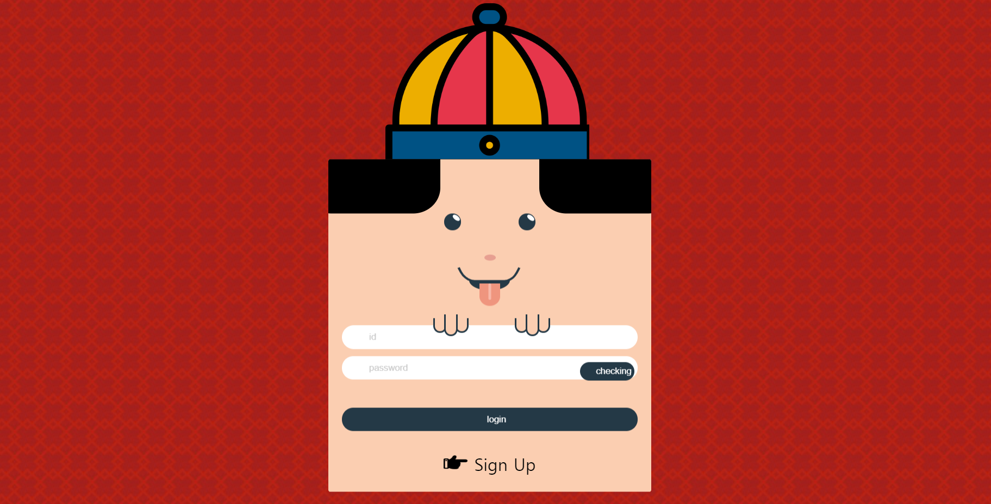
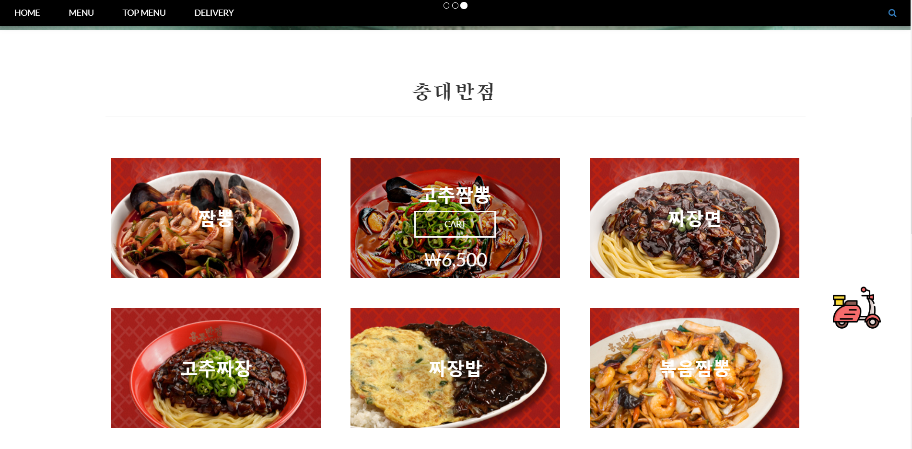
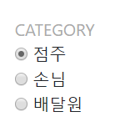
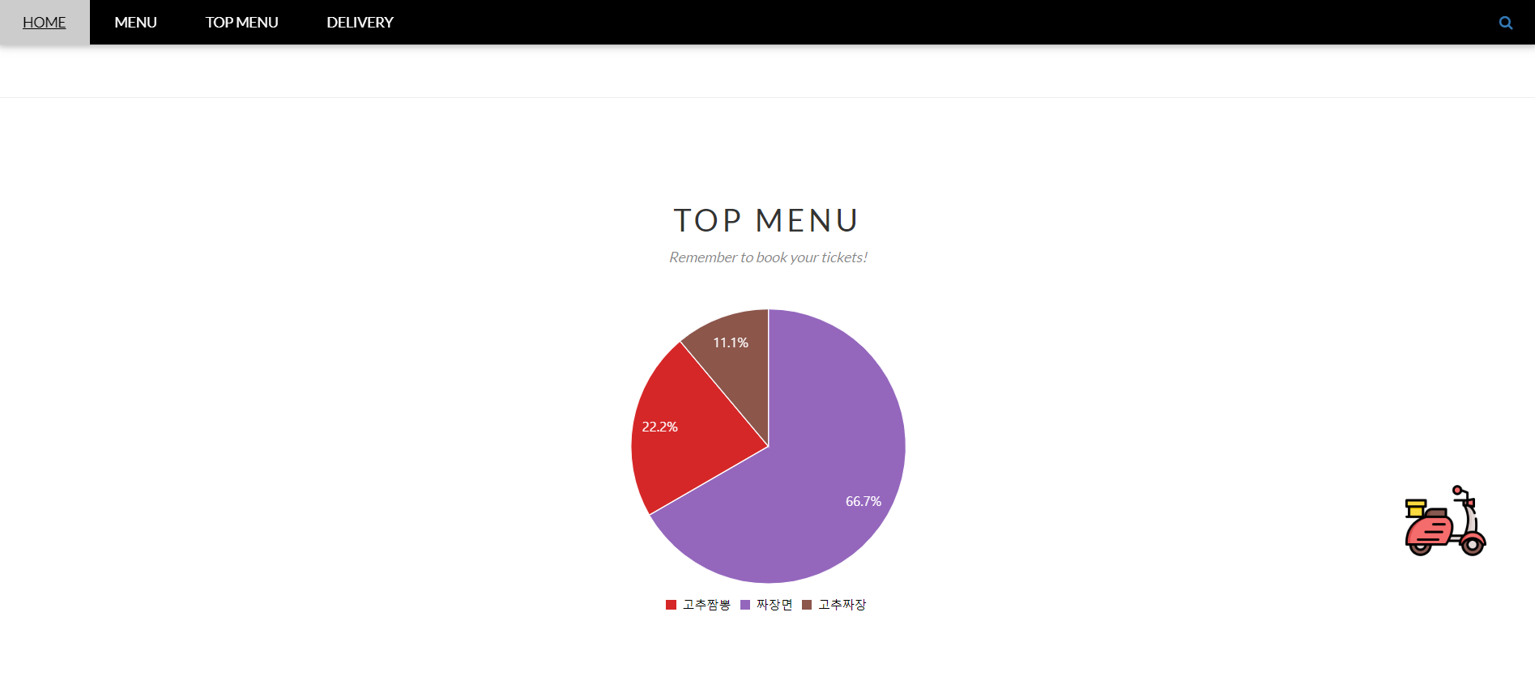
3. Details of proposed idea
Your idea in details
User can sign up by pressing one of these buttons.
Orderer, Store owner, deliverer.
- Delivery orderer can select the menu
by pressing the image button.
The selected menu is added
to the shopping cart.
- The top menu is shown as a chart.

Slide 8
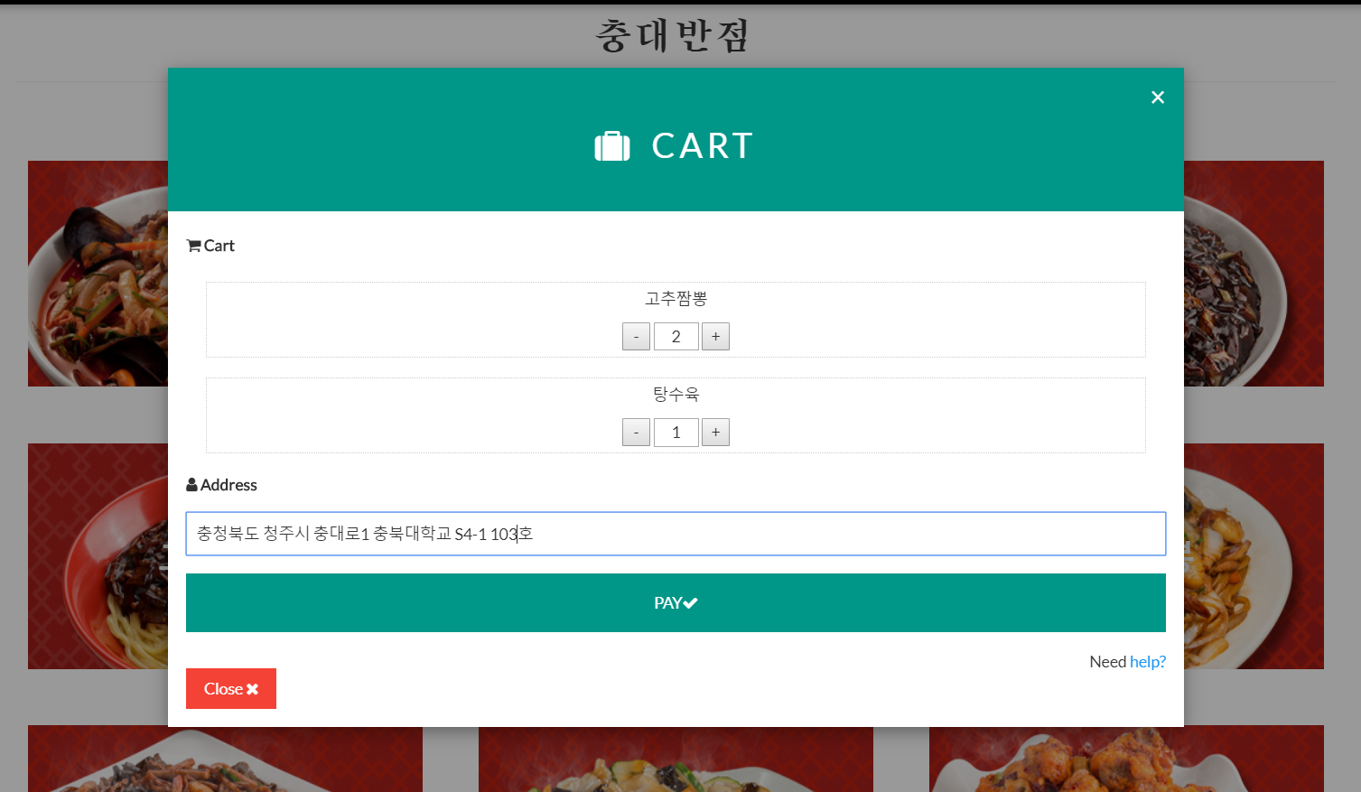
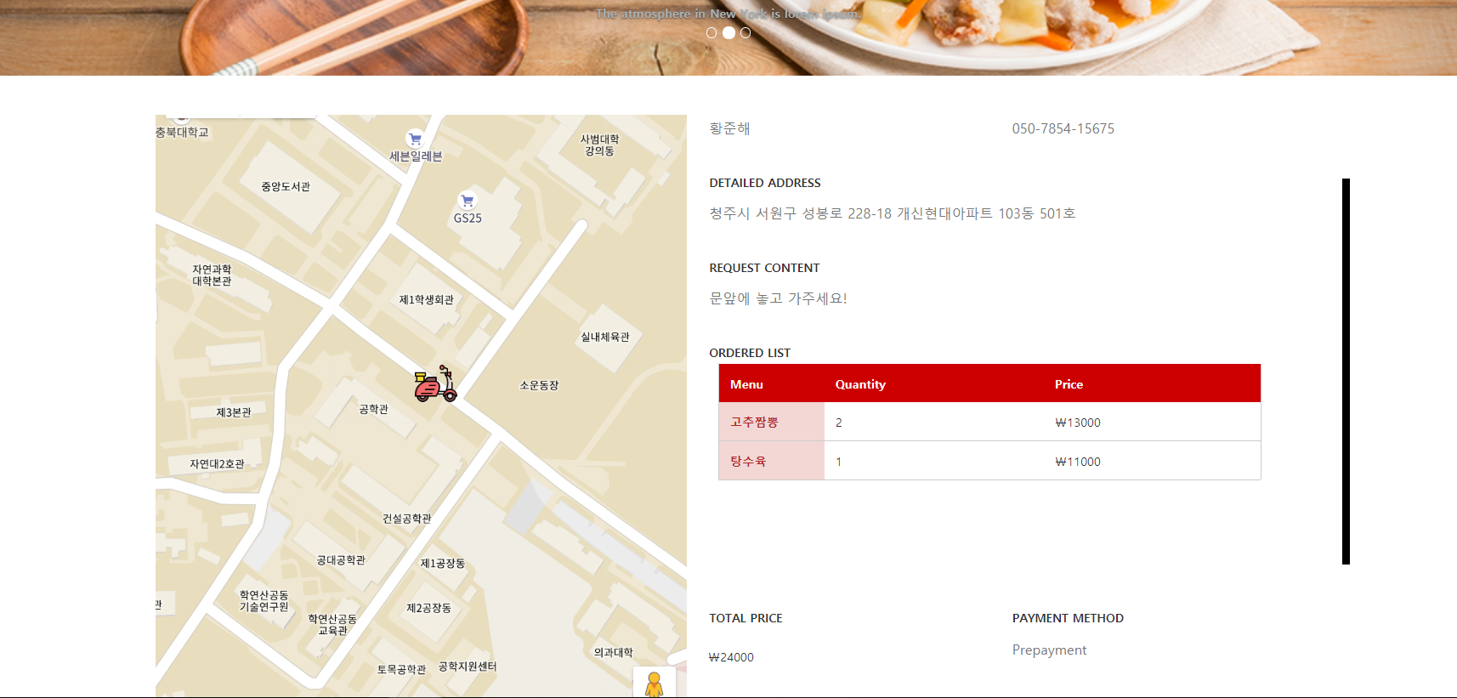
3. Details of proposed idea
- Orderer can create an order form.
- The location of the delivery man is displayed in real time.
- Using Google maps API

Slide 9
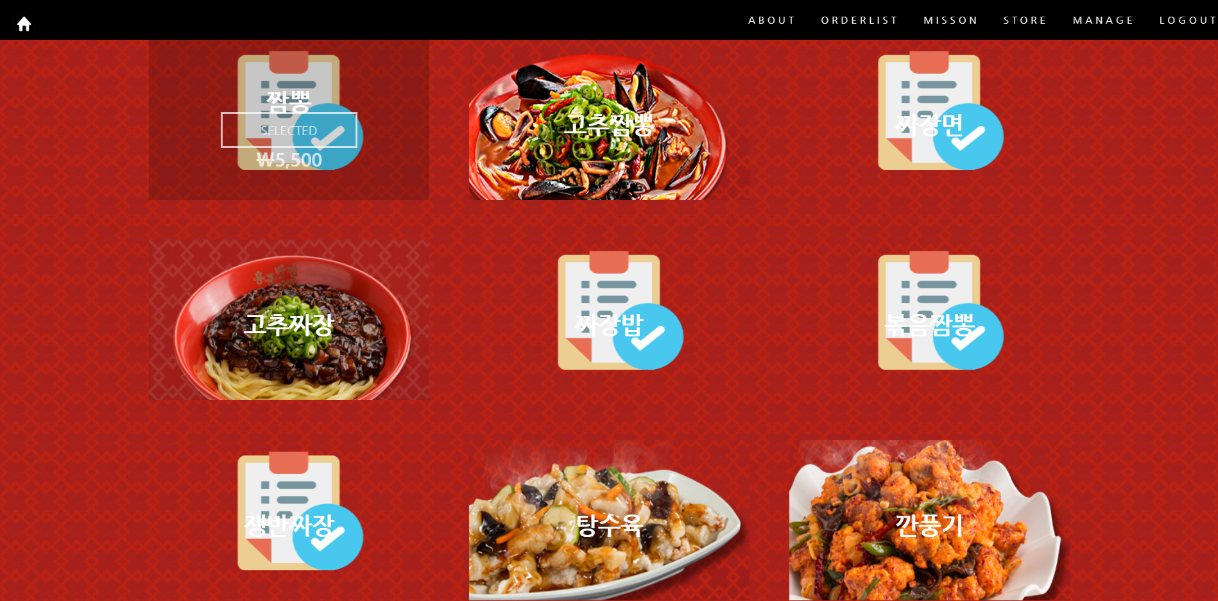
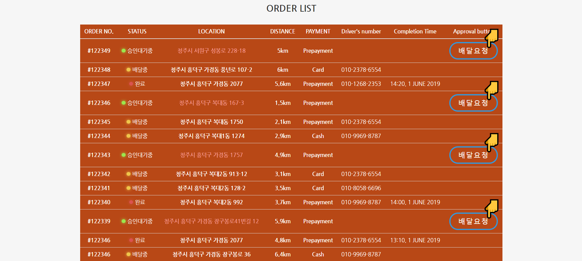

3. Details of proposed idea
- The store owner can view the delivery list and make a delivery request.
-Store owner can manage menus and store’s status.

Slide 10
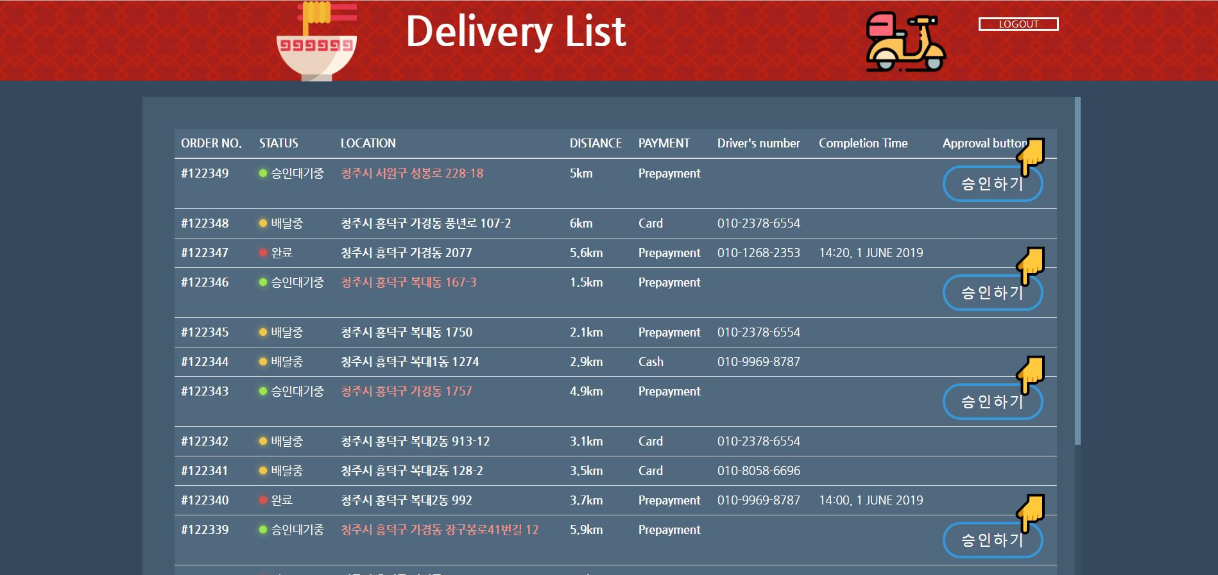
3. Details of proposed idea
-The delivery man can view the list of deliveries.

Slide 11
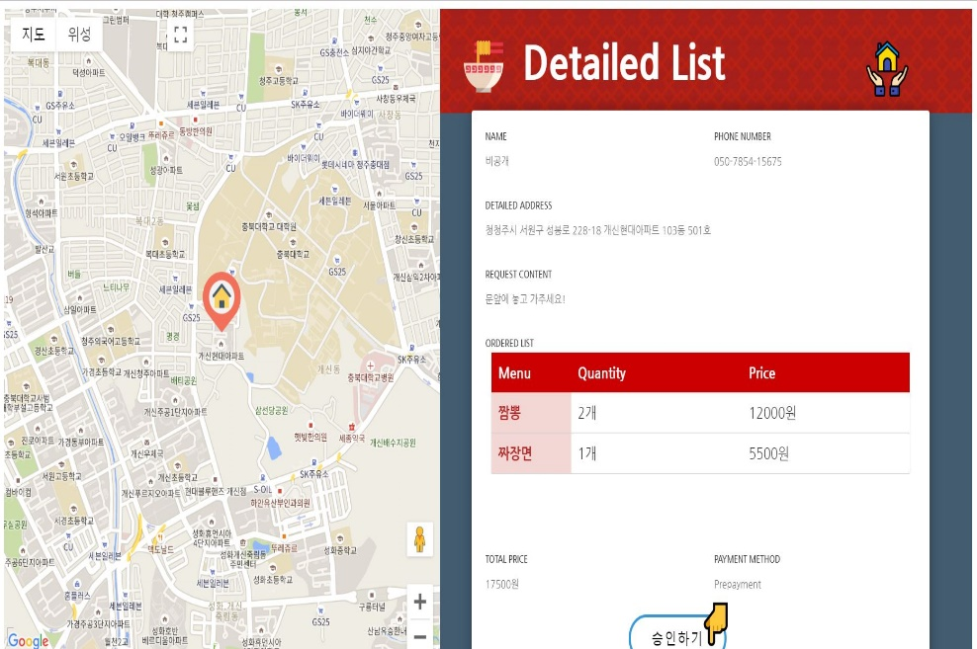
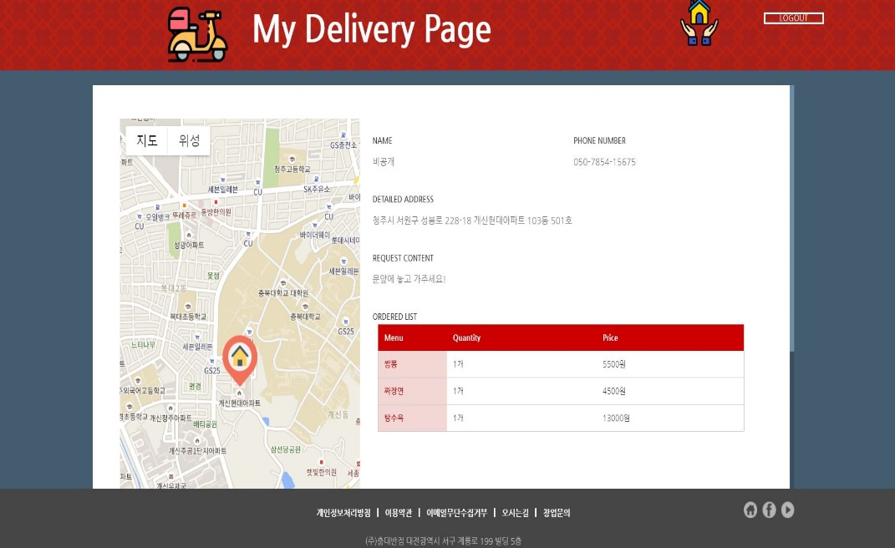
3. Details of proposed idea
- The deliveryman can check the details and the delivery list approved.

Slide 12


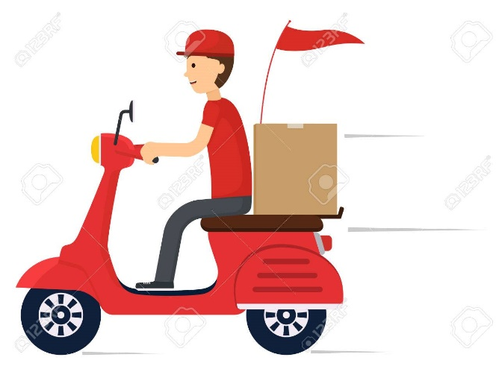

4. Benefits
Advantages of your project
Orderer can know the real-time
location of delivery.
All functions are available on one system.
Show order of food using order data.

Slide 13
5. Demo
Demonstrate your application
실행

Slide 14
6. Conclusion
What was your experience working on this project

Slide 15
Q & A

